Slide 1
Topic: Finance - Extension EQ: What happens with your Superannuation?
Year 10 Mathematics

Slide 2
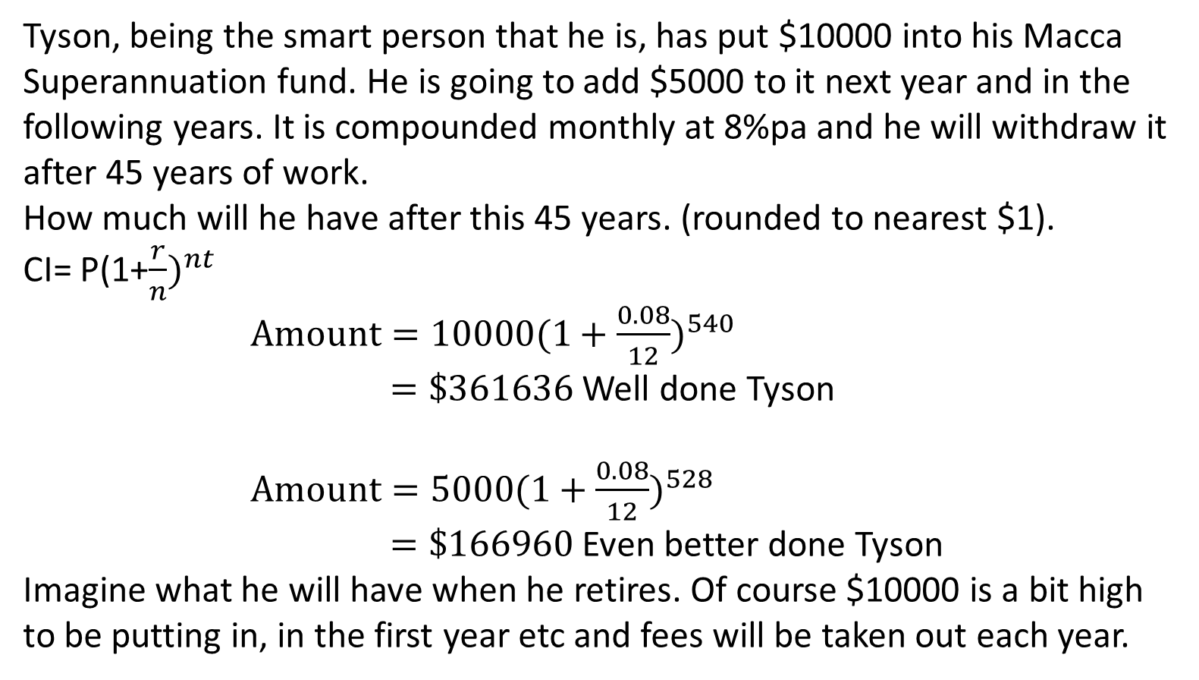
24
7
30
Topic: Finance - Extension
Date:
EQ: What happens with your Superannuation?
Tyson, being the smart person that he is, has put $10000 into his Macca Superannuation fund. He is going to add $5000 to it next year and in the following years. It is compounded monthly at 8%pa and he will withdraw it after 45 years of work.
How much will he have after this 45 years. (rounded to nearest $1).
CI= P(1+$\frac{r}{n})^{nt}$
$Amount=10000(1+\frac{0.08}{12})^{540}$ $=\$361636$ Well done Tyson
$Amount=5000(1+\frac{0.08}{12})^{528}$ $=\$166960$ Even better done Tyson
Imagine what he will have when he retires. Of course $10000 is a bit high to be putting in, in the first year etc and fees will be taken out each year.
Tyson’s Super?
Compounded 540 times, 12 times a year for 45 years
Compounded 528 times, 12 times a year for 44 years
Notes:
If students don’t know where to begin, give them a clue that they need to use Order of Operations to link the numbers on the vertices to the number inside the triangle.

Slide 3
24
7
30
Topic: Finance - Extension
Date:
EQ: What happens with your Superannuation?
Larissa, is starting up her superannuation with Macca Super. She is putting in $5000 in the first year and $5500 in the next one and going up by $500 each year after that. How much will she get after 42 years work for her first amount and the second, it is compounded monthly at 8%pa.
Maddie D. is starting with $3000 for the first year and going up by $1000 each year. How much will she get for the first and 4th amount after 40 years of work?
Brandon decides, he is going to put $30000 in, in the first year and another $30000 in, in the second and nothing after that. How much will he get after 42 years of work?
Try these.
Notes:
If students don’t know where to begin, give them a clue that they need to use Order of Operations to link the numbers on the vertices to the number inside the triangle.

Slide 4
1 | 5000 | 5000 | 5414.998
2 | 5100 | 10515 | 11387.74
3 | 5202 | 16589.74 | 17966.68
4 | 5306.04 | 23272.72 | 25204.34
5 | 5412.161 | 30616.5 | 33157.66
6 | 5520.404 | 38678.06 | 41888.32
7 | 5630.812 | 47519.13 | 51463.2
8 | 5743.428 | 57206.63 | 61954.75
9 | 5858.297 | 67813.04 | 73441.49
10 | 5975.463 | 79416.96 | 86008.52
11 | 6094.972 | 92103.5 | 99748.04
12 | 6216.872 | 105964.9 | 114759.9
13 | 6341.209 | 121101.2 | 131152.5
14 | 6468.033 | 137620.5 | 149043
15 | 6597.394 | 155640.4 | 168558.4
16 | 6729.342 | 175287.8 | 189836.6
17 | 6863.929 | 196700.5 | 213026.5
18 | 7001.207 | 220027.7 | 238289.9
19 | 7141.231 | 245431.2 | 265801.8
20 | 7284.056 | 273085.9 | 295751.9
21 | 7429.737 | 303181.6 | 328345.6
22 | 7578.332 | 335923.9 | 363805.4
23 | 7729.898 | 371535.3 | 402372.5
24 | 7884.496 | 410257 | 444308.2
25 | 8042.186 | 452350.4 | 489895.2
26 | 8203.03 | 498098.3 | 539440.2
27 | 8367.091 | 547807.3 | 593275
28 | 8534.432 | 601809.4 | 651759.3
29 | 8705.121 | 660464.4 | 715282.6
30 | 8879.223 | 724161.9 | 784266.9
31 | 9056.808 | 793323.8 | 859169.2
32 | 9237.944 | 868407.2 | 940484.5
33 | 9422.703 | 949907.2 | 1028749
34 | 9611.157 | 1038360 | 1124544
35 | 9803.38 | 1134347 | 1228497
36 | 9999.448 | 1238497 | 1341291
37 | 10199.44 | 1351491 | 1463664
38 | 10403.43 | 1474067 | 1596414
39 | 10611.49 | 1607026 | 1740408
40 | 10823.72 | 1751232 | 1896583
41 | 11040.2 | 1907623 | 2065955
42 | 11261 | 2077216 | 2249624
43 | 11486.22 | 2261110 | 2448781
44 | 11715.95 | 2460497 | 2664717
45 | 11950.27 | 2676667 | 2898829
If Larissa’s starting wage is $50 000 and 10% is put away as superannuation. If her wage and super is increased by 2% per year, after 45 years of work when she wants to retire, Larissa will have $2898829 for her retirement.
This sounds a lot at the moment but don’t forget her wage after 45 years is about $120 000 also fees are being taken out and the government will take 15% tax.
Say fees are $1000 per year that will take $45000 leaving $2853829 and the 15% tax will leave you with
$2 425 755
To live on in retirement and don’t forget prices will still be going up.
She might have to think about it and put some more away at the start if she can afford it.

